Slide 1

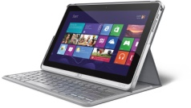


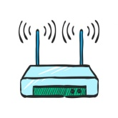


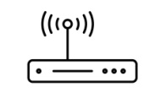

Sending Data From One Computer to Another
Mike
John
I.P. 192.168.1.4
I.P. 192.168.0.4
Hello!
Hello!
I.P. 192.168.1.3
I.P. 192.168.1.2
Backend Server
router
router
I.P. 192.168.1.2
firewall
firewall
firewall
Frontend Server
I.P. 12.12.123.15
I.P. 12.12.123.15
modem
modem
I.P. 12.12.123.18
firewall

